Slide 1
web performance optimization
Generate the performance report
Measuring performance
What was implemented

Slide 2
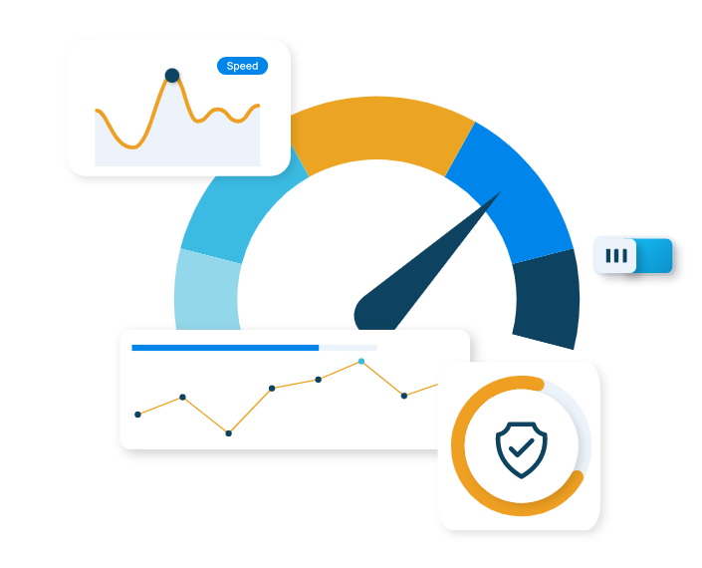
Web performance is about how quickly content loads and the way it responds users to interaction.
WHY IS WEB PERFORMANCE IMPORTANT?
It’s a good practice to test performance on same devices that the users have and choose the slowest devices
And to test performance on regular base, monthly.

Slide 3
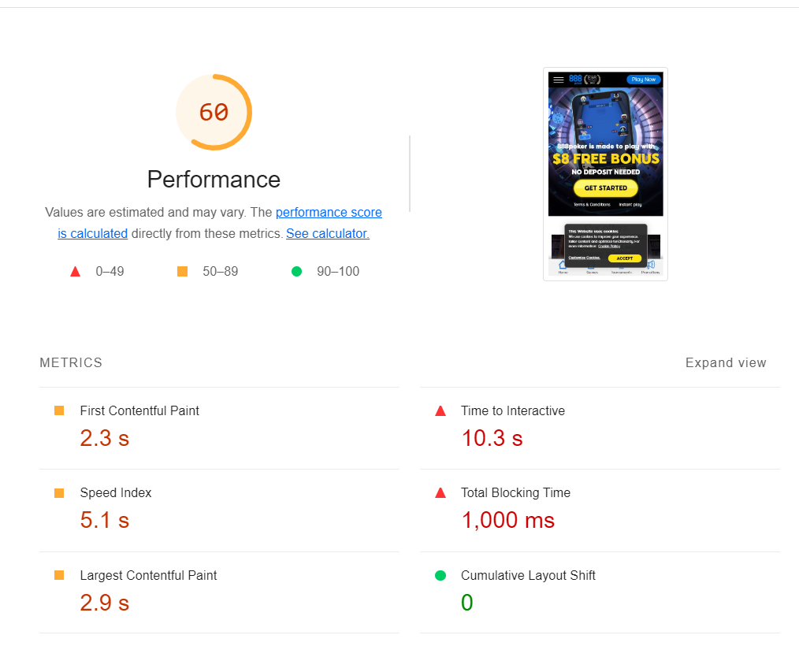
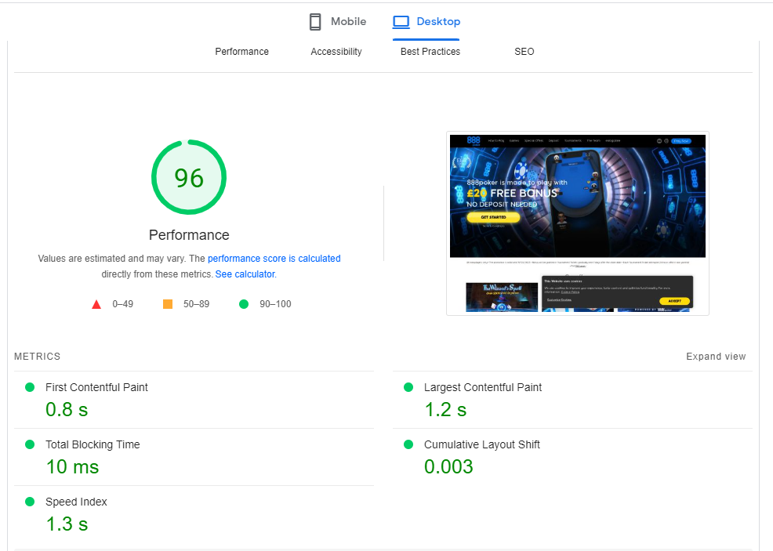
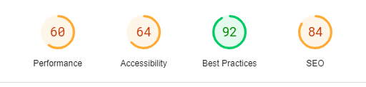
Performance reports
– Lighthouse report – dev tools
- https://pagespeed.web.dev/

Slide 4
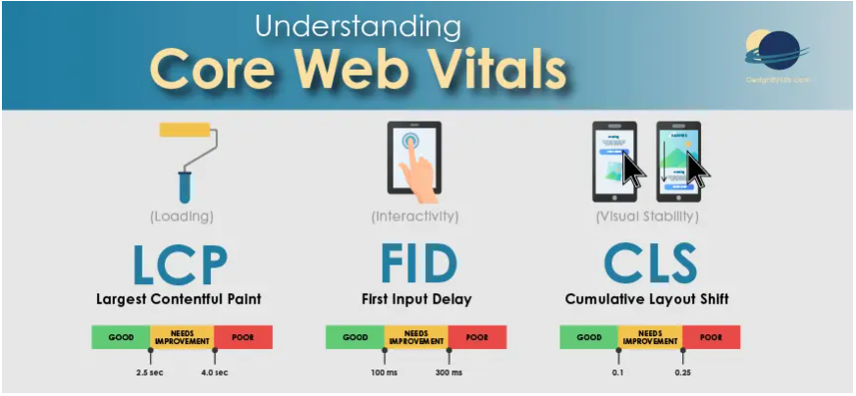
Largest Contentful Paint (LCP): measures how quickly the largest content element on the page (e.g. an image or video) is loaded.
First Input Delay (FID): measures how quickly the website responds to a user's first interaction (e.g. clicking a button).
Cumulative Layout Shift (CLS): measures how much the page layout shifts during loading.

Slide 5
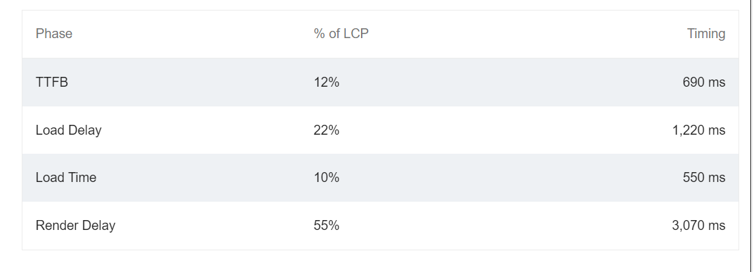
LCP depends on:
Time to First Byte – the time calculated from the browser’s request until the first byte of data received from a web server: reducing the redirects, serve from single domain, use a better protocol, like http2
Resource load delay - by adding fetchpriority or loading = eager; less complex DOM
Resource load time - reduce the size of bytes transferred over the network (img type)
element render delay - inline critical css, defer js, never lazy load LCP

Slide 6

CLS : the layout of a web page changes unexpectedly as the page loads, causing elements to shift or move around.
This means to avoid adding new content or changing the layout of existing content after the page has started loading. Dimensions should be added to all images and videos.

Slide 7
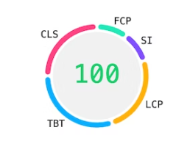
Other Web Vitals Metrics
First Contentful Paint (FCP) - measures how quickly the first piece of content is painted on the user's screen
Total Blocking Time (TTB) - measures the total amount of time that a webpage is blocked from responding to user input during the loading process.
Speed Index (SI) - to measure the perceived speed of a web page

Slide 8
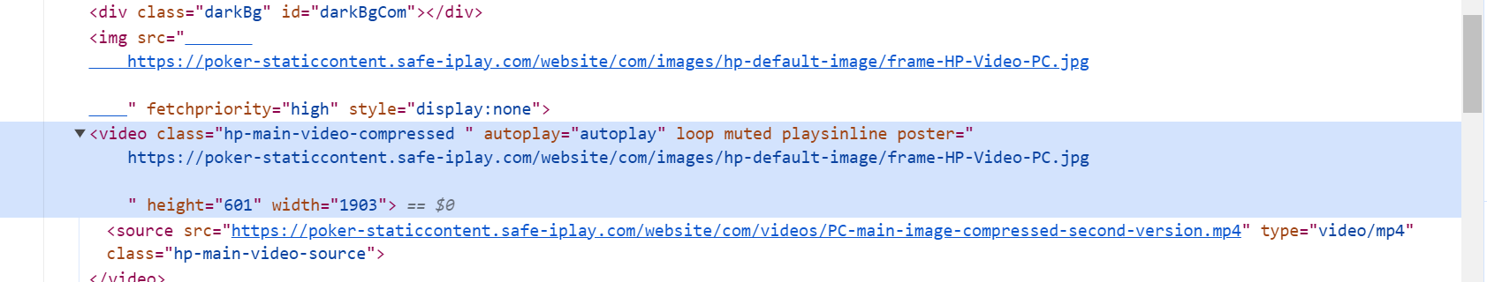
Areas to improve performance

Slide 9
